Slide 1


Sales Forecasting Across Multiple Retail Stores

Slide 2
Introduction
Our goal is to investigate how customers behave in the different establishments.
Our objective is to determine how certain actions, including promotions and the opening of new locations, impact consumer behavior and to create and provide an
final product that provides the finance team's analysts with this forecast.

Slide 3
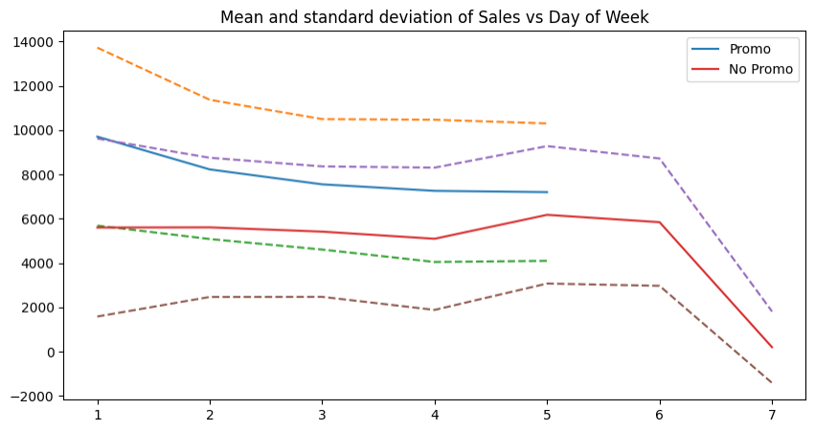
Promotions are correlated with more sales and customers

Slide 4
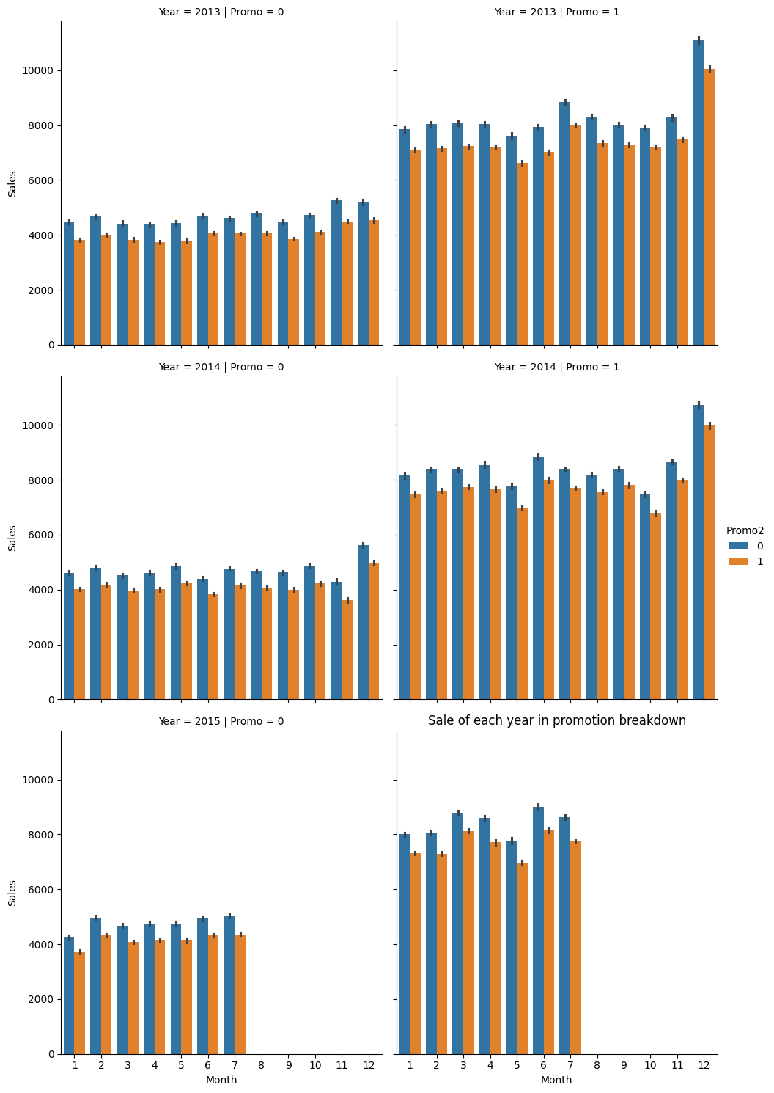
Sale of each
year in
promotion
breakdown
We observe that both the company's jointly planned marketing and the campaigns run by the retailers themselves have a positive impact on sales.

Slide 5
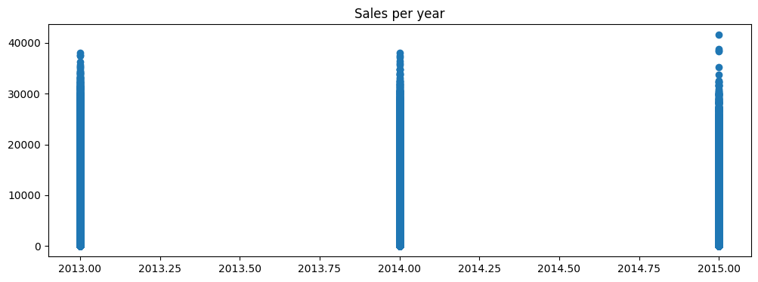
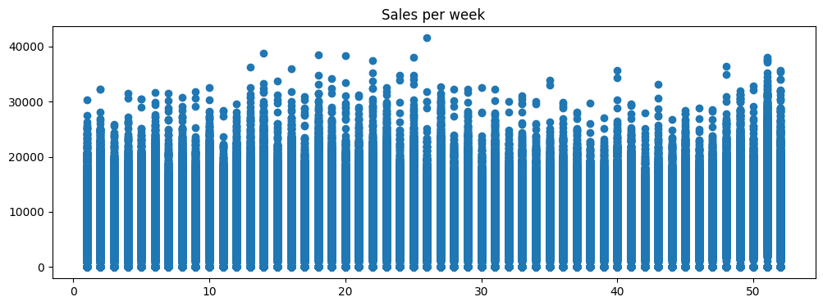
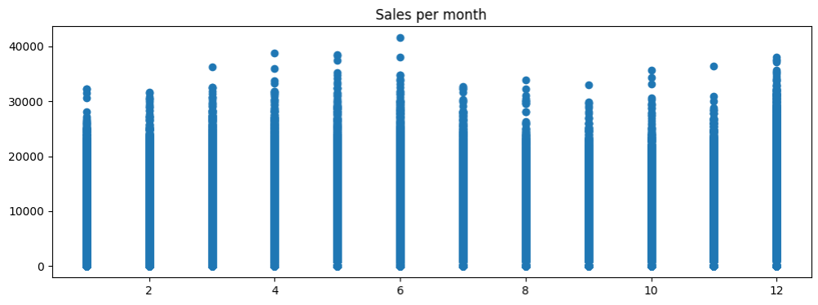
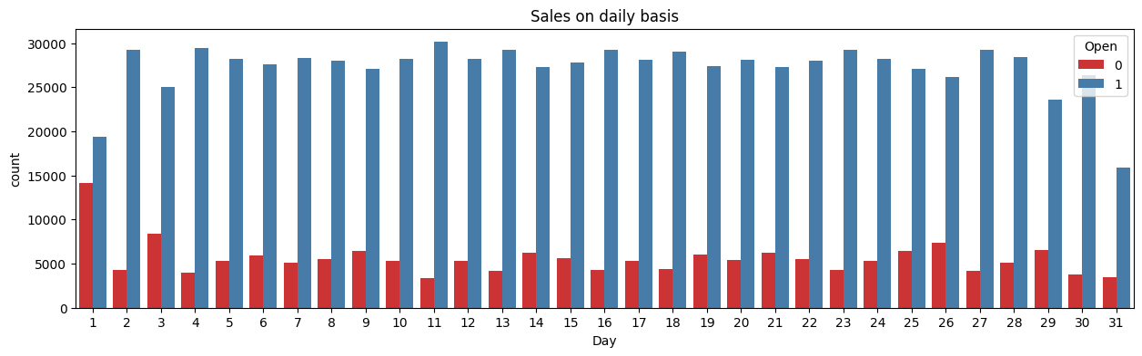

Slide 6
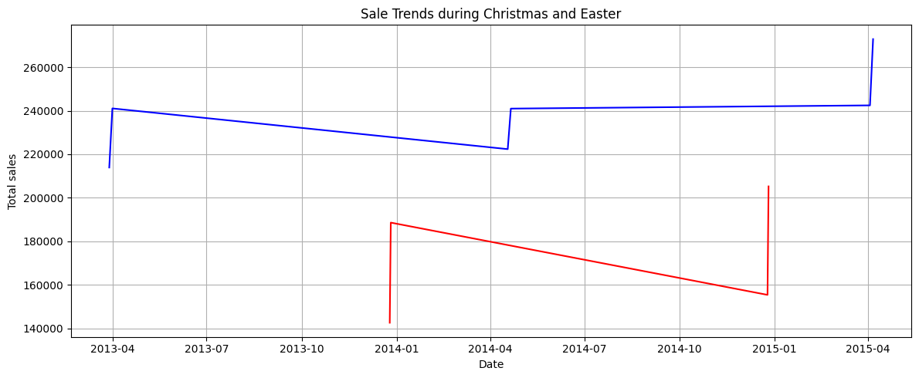
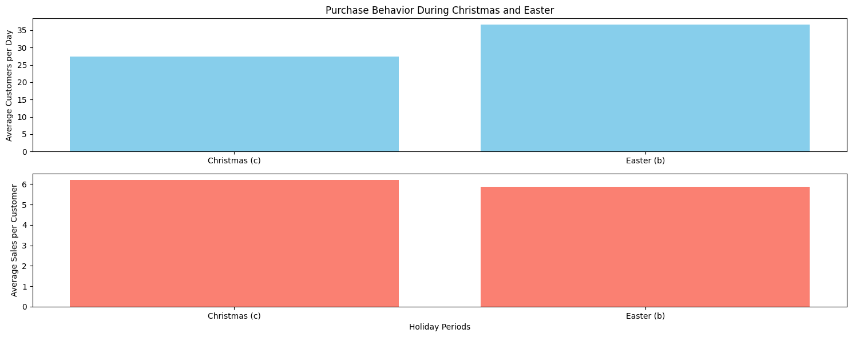

Slide 7
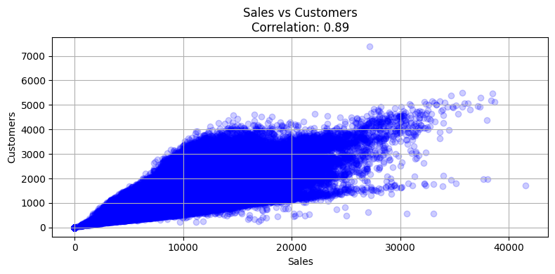
The correlation between
Sales & Customers is 89%
which is good

Slide 8
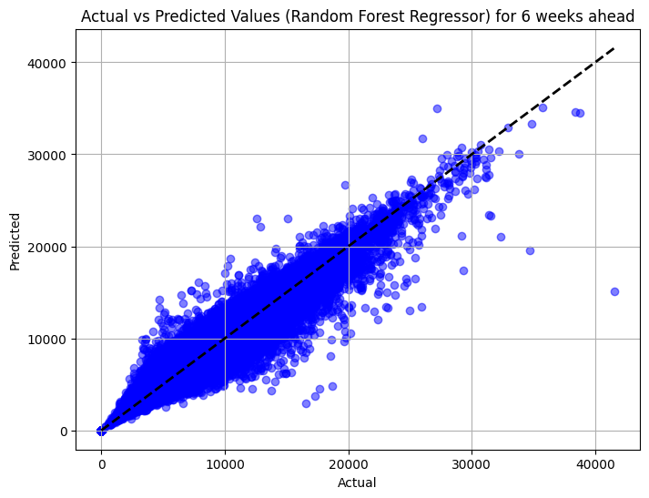
Random
Forest
Regressor with
pipeline
Score = 96.13

Slide 9
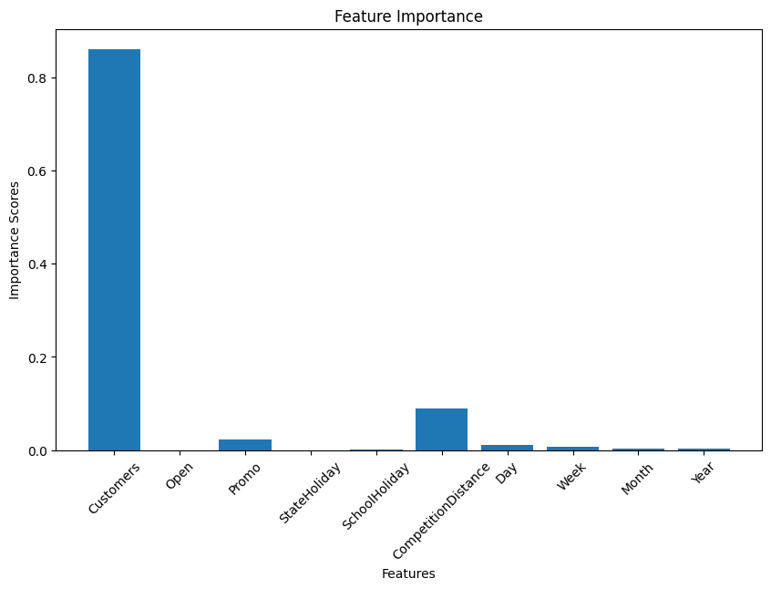
Customers is
the most
important
feature which
increases the
Sales

Slide 10
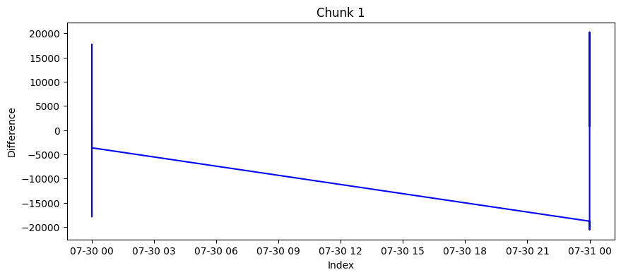
Chunk 1
ADF statistics: -15.454115638809549
p-values: 2.7596216659777057e-28
Critical Values: {'1%': -3.433665351698571, '5%': -
2.8630045337025267, '10%': -2.567549656849864}
Reject the null hypothesis - Data is stationary

Slide 11
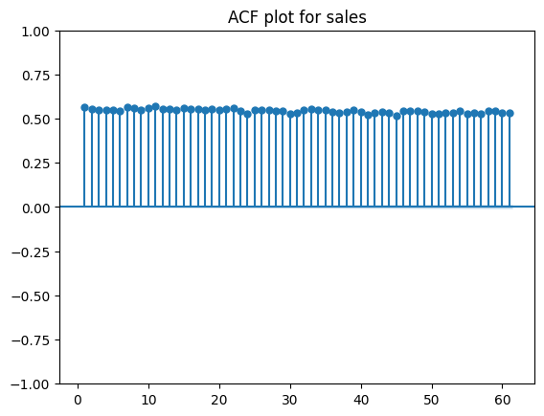
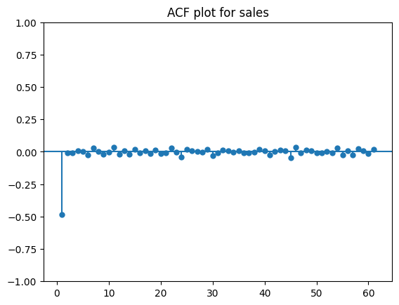
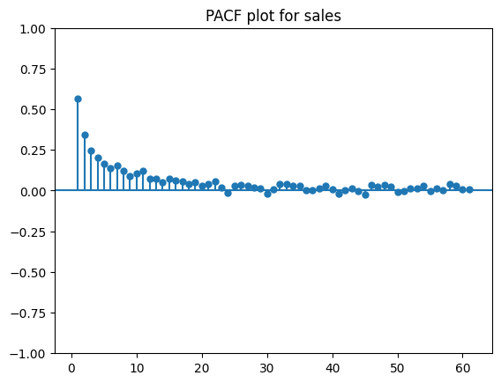
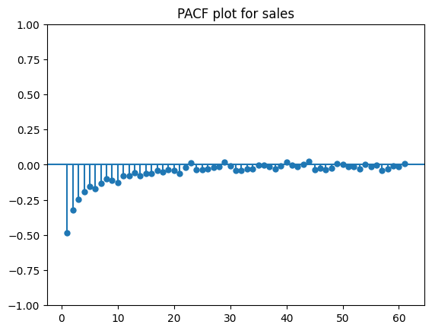

Slide 12
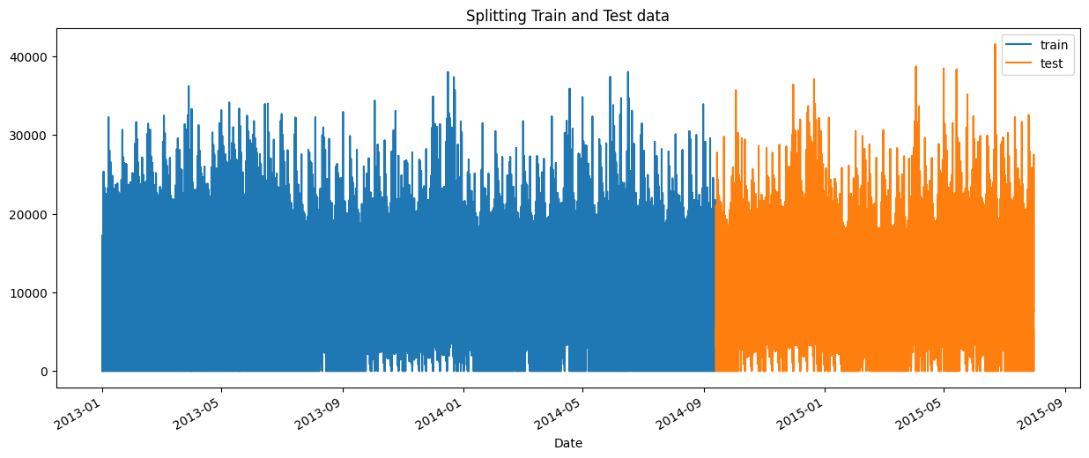
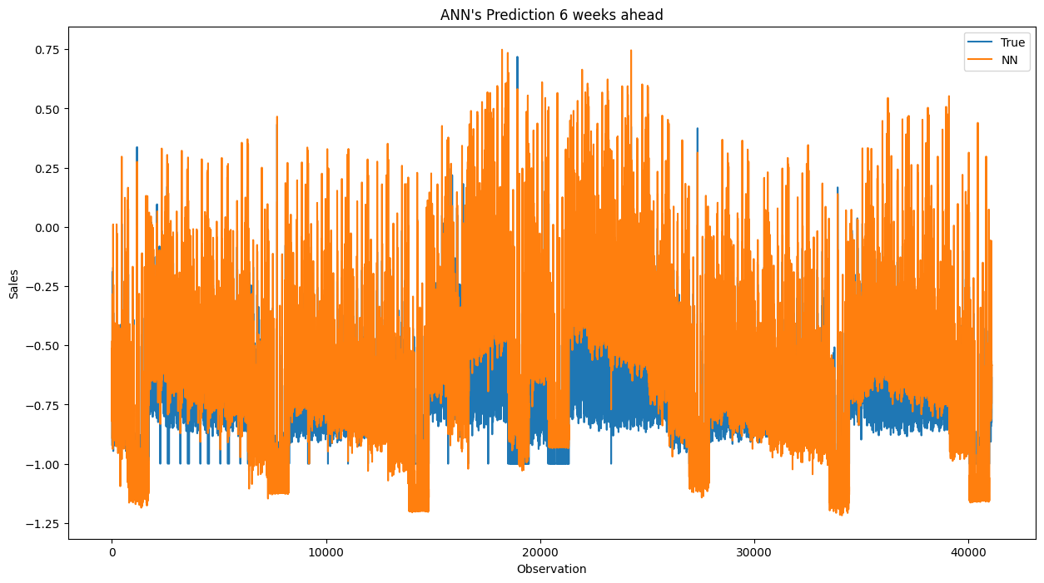

Slide 13
Focus areas
We should bear in mind that this is a simplistic demonstration, using only a single store's data and making relatively basic assumptions (e.g., no promotional or holiday effects other than weekly and yearly seasonality). It would be wise to combine data from several stores and possibly take into account extra aspects like deals, holidays, and other outside variables that could affect sales in order to create a more accurate and reliable forecast.

Slide 14
In brief
A portion of the data's seasonality has been effectively captured by the model. It forecasts an increase in sales around the end of the year, which corresponds with the spike in holiday shopping. This is encouraging since it shows that the model has taken into account both the timing and the raw sales data.

